Slide 1
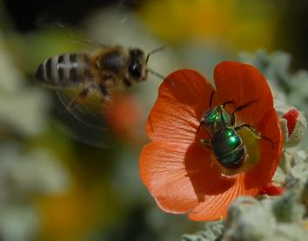
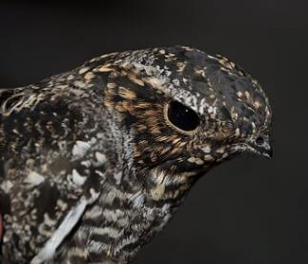
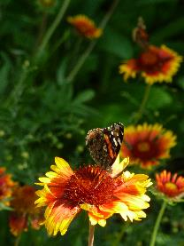
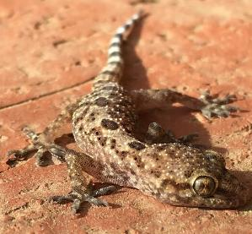
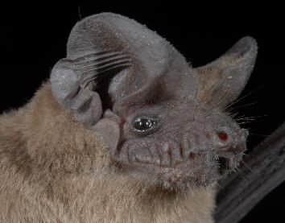
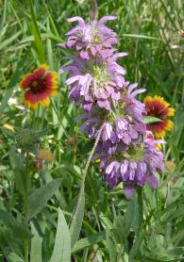
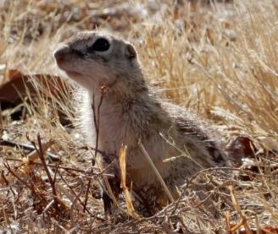
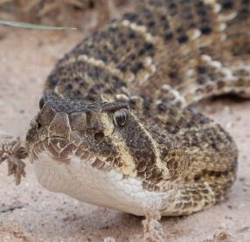
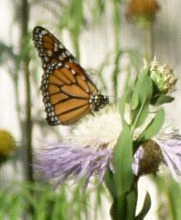
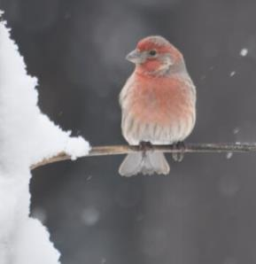
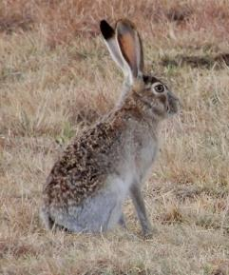
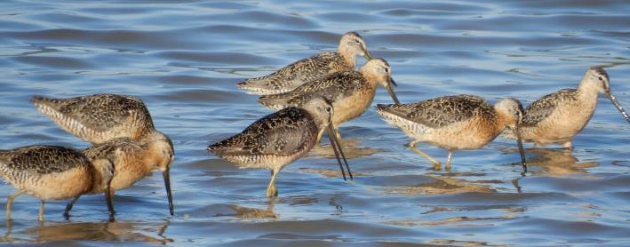
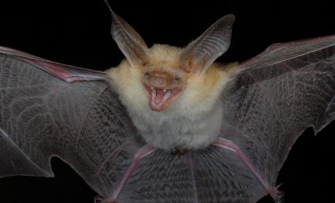
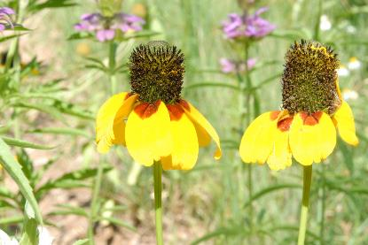
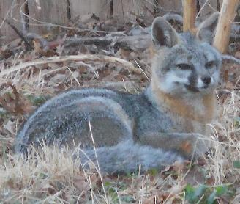
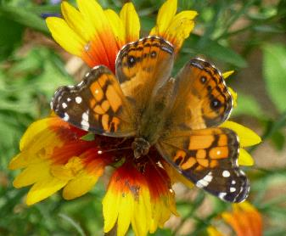
Attention Undergrads Department of Biological Sciences invites you to join BioBlitz 2019 When: 27-28th September Where: Tahoka Lake Pasture How: Sign up in the Bio office
Notes:
Lubbock Has 378 birds records..

Slide 2
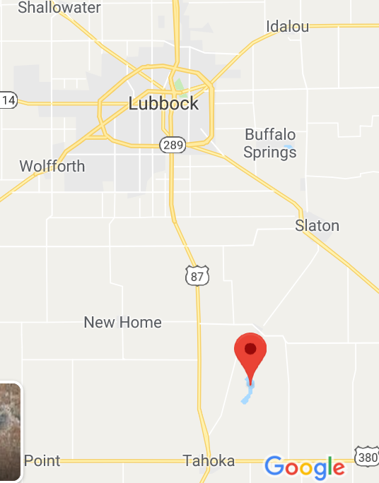
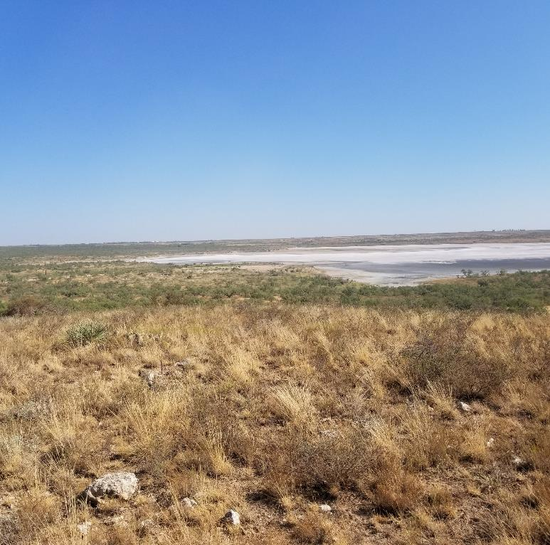
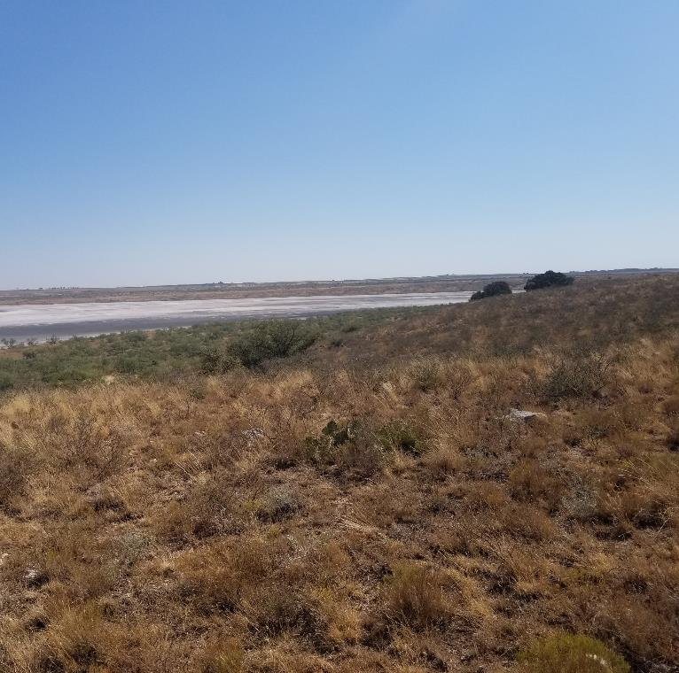
Where : Tahoka Lake Pasture

Slide 3
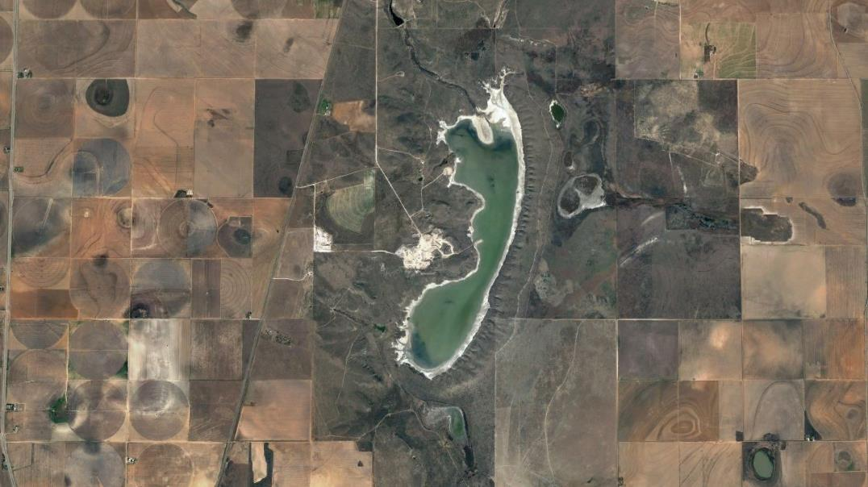
Tahoka Lake Pasture is…
A rare saline (salty) playa edged with natural vegetation
Set in a sea of agriculture and threatened by a caliche quarry
The quarry
OUR MISSION
DESCRIBE THE BIODIVERSITY AROUND THE PLAYA WITH A BioBLITZ!

Slide 4
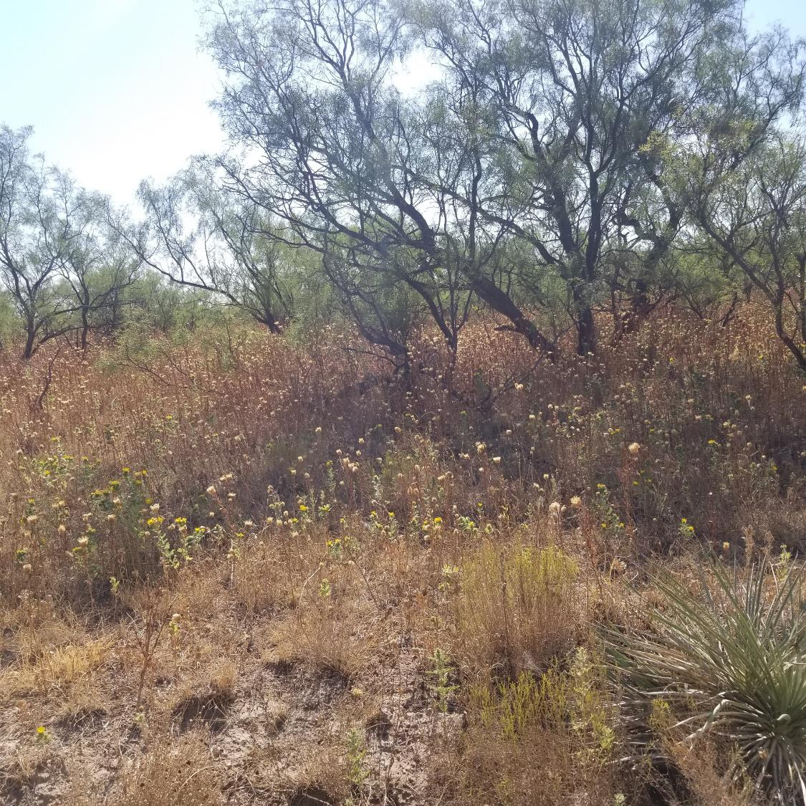
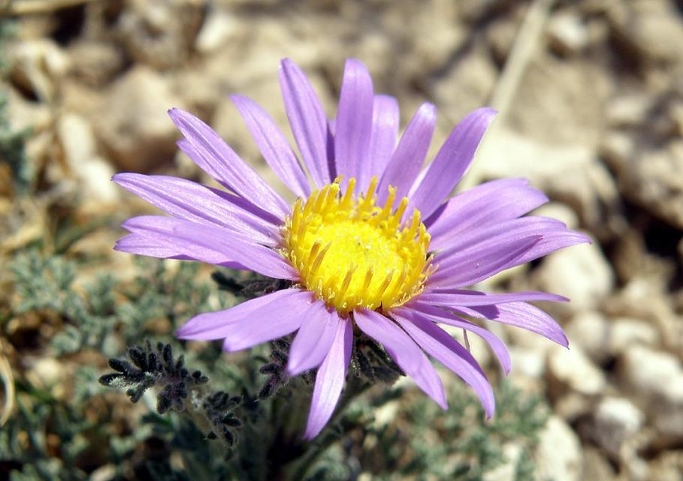
What is a BIOBLITZ?
“an intense period of biological surveying in an attempt to record all the living species within an area”

Slide 5
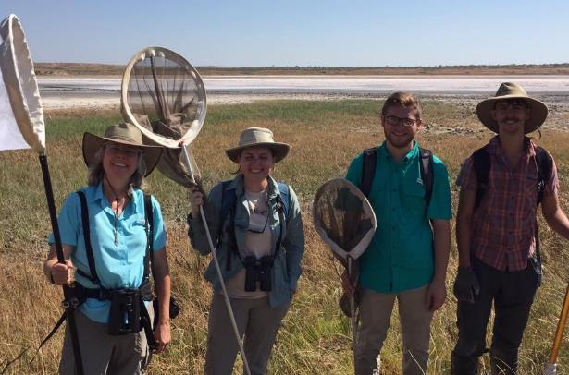
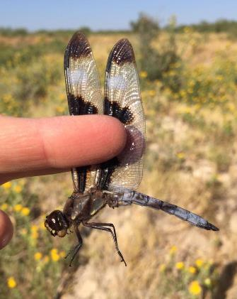
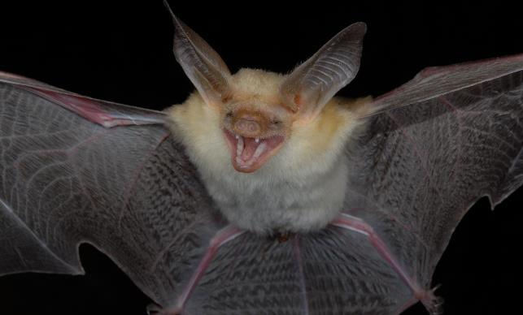
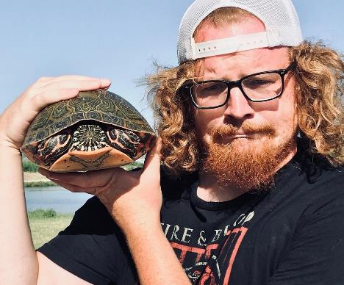
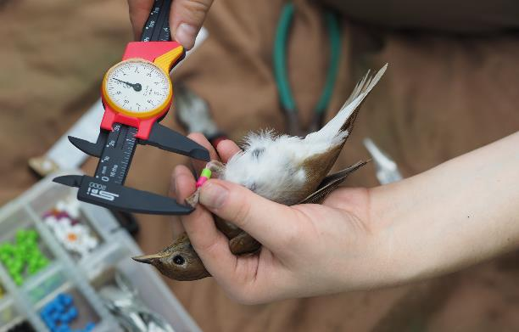
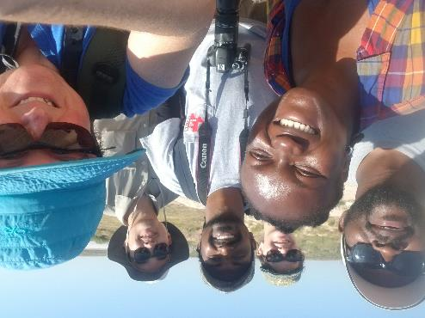
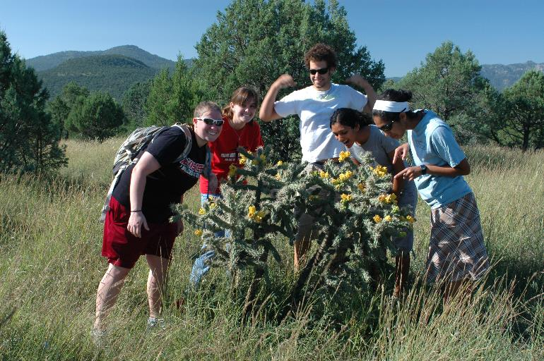
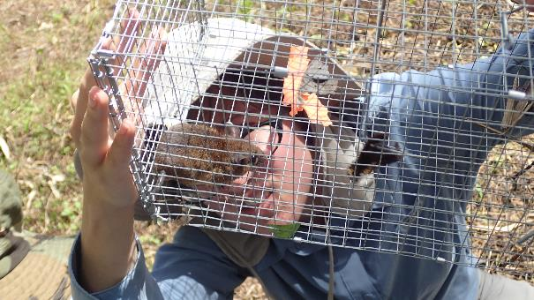
We will survey by capture, collection and observation
Dragonflies
Herps
Bats
Birds
Rodents
Plants

Slide 6
Dates and Times and Groups
27th September -- 2pm – late (11 pm +) BATS, SMALL MAMMALS
27th September -- 6pm – late HERPS (amphibians and reptiles)
28th September – 7.30 am – mid-late afternoon – BIRDS, SMALL MAMMALS, PLANTS, DRAGONFLIES, HERPS, (BATS)
SIGN UP: Bio Department Front Office

Slide 7
JOIN US!!!
Contact: Dr Kingston – tigga.kingston@ttu.edu
Sign up in the Bio office
Notes:
Lubbock Has 378 birds records..

